Slide 1
Black Box Monitoring in Go An introduction to Building Black Box monitors Go
Grant Griffiths
Software Engineer
Platform Cloud Engineering
GE Digital

Slide 2

Who am I?
GE Digital - Platform Cloud Engineering
Sr. Software Engineer
San Francisco, CA
GE Go User Group
Founder & Organizer
@ggriffiths
@griffithsgrant
Climbing + Mountaineering

Slide 3

Engineering @ GE
Introduction to Black Box Monitoring
Black Box monitoring @ GE
Sample black box monitor
Takeaways

Slide 4
Who here has owned a GE
Fridge, Lightbulb, or Microwave?

Slide 5
Actually, we make
HUGE Industrial assets…

Slide 6
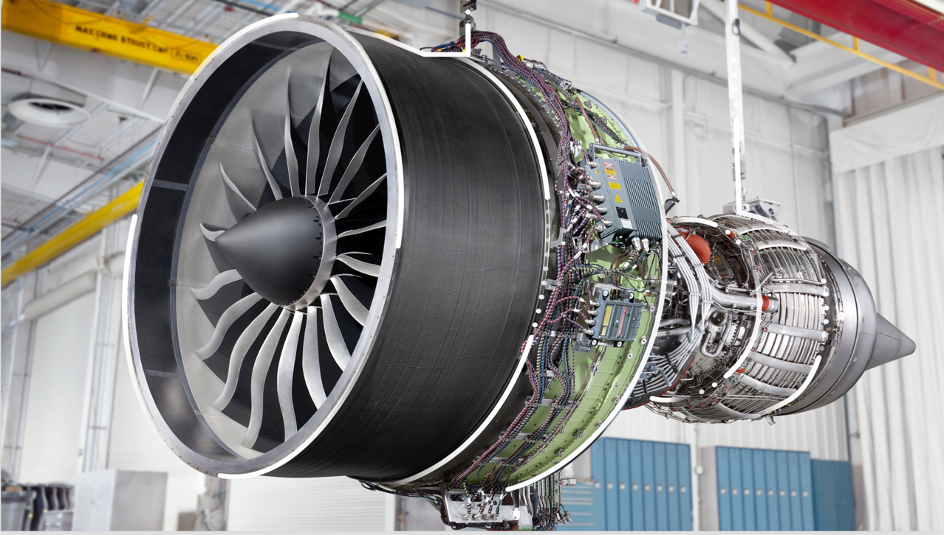

Slide 7


Slide 8
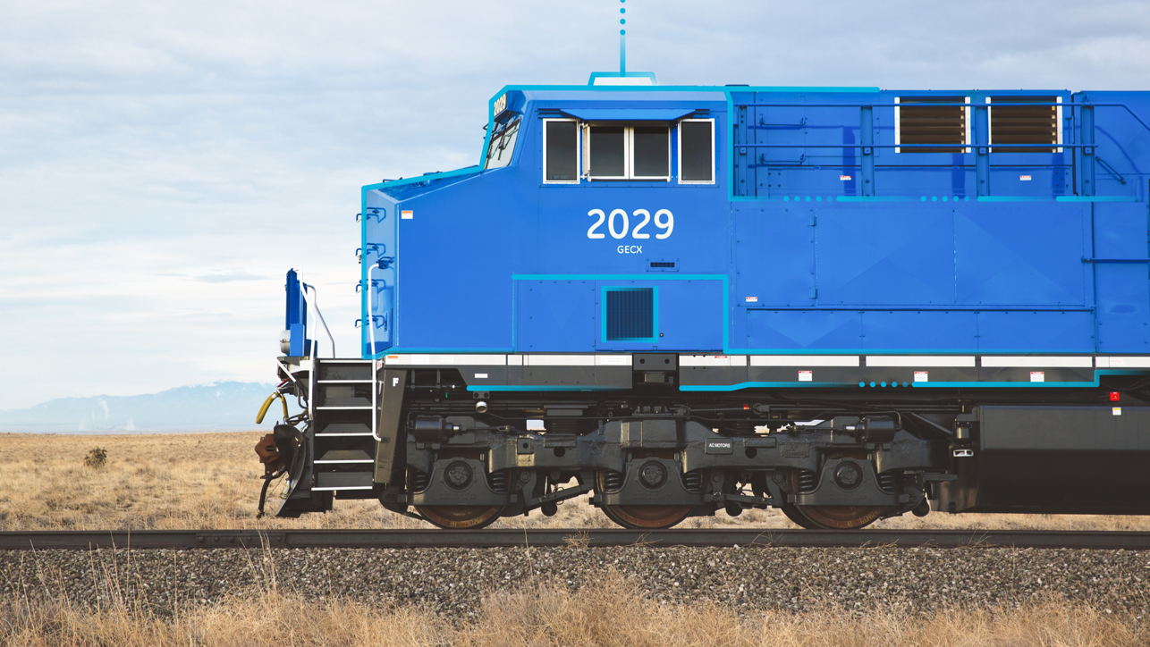

Slide 9

Fun facts about GE
GE Power generates roughly 33% of the world’s electricity
Every two seconds, an aircraft powered by GE takes off
35,000 wind turbines globally
25% of all global hydropower

Slide 10
Some customers
Schindler
Exelon
Rosneft
BP
GE Power
GE Aviation
GE Renewables

Slide 11


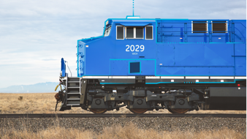
Industrial Internet of Things (IIoT)
GE Assets produce petabytes of useful and mission critical data
Store and analyzed in Predix, our platform for IIoT
Downtime can have huge impact – lives lost and million of dollars
We must focus on reliability and availability

Slide 12
Engineering @ GE
Introduction to Black Box Monitoring
Black Box monitoring @ GE
Sample black box monitor
Takeaways

Slide 13
Google SRE book

Slide 14
Site Reliability Engineering
“Fundamentally, it’s what happens when you ask a software engineer to design an operations function.”
- Ben Treynor, VP of Engineering @ Google
Using software expertise to solve operations problems through automation
Google SRE Book - landing.google.com/sre/book
Additionally, (Site Reliability workbook free to download until Aug 23)
Covers monitoring amongst many other topics

Slide 15
What is Black Box Monitoring?
Testing externally visible behavior as a user would see it
Questions that it answers
Is my service up?
Is my service consumable?
Is a dependency of my service down?
Node uptime != service uptime

Slide 16
What is NOT Black Box monitoring?
White box monitoring
CPU/RAM/Disc utilization
JVM stats
pprof/tracing
Logging
System internals
Individual component health checks
Anything the user cannot find out

Slide 17
What are probes?
Small applications that measure service uptime
Knows nothing about system internals
Simulates an end user (black box)
Automated, pages engineers upon failures

Slide 18
Simple REST API Architecture
User 1
User 2
User n
GET /v1/users
PostgreSQL
REST API

Slide 19
Let’s add a Probe to monitor it
APM Solution
(New Relic, etc)
User 1
User 2
User n
Probe
Every X
seconds
GET /v1/users
GET /v1/users
PostgreSQL
REST API
Query success

Slide 20
Service queries DB
APM Solution
(New Relic, etc)
User 1
User 2
User n
Probe
Every X
seconds
GET /v1/users
GET /v1/users
PostgreSQL
REST API
Query
Failed

Slide 21
Probe returns 500
APM Solution
(New Relic, etc)
User 1
User 2
User n
Probe
Return
500
GET /v1/users
GET /v1/users
PostgreSQL
REST API
Query
Failed

Slide 22
Page engineer on PostgreSQL team
zZZ
APM Solution
(New Relic, etc)
User 1
User 2
User n
Probe
Return
500
Page sleeping
Engineer
GET /v1/users
GET /v1/users
PostgreSQL
REST API
Query
Failed

Slide 23
Monitoring a simple REST API – Problem fixed by engineer
Auto healing
would be nice…
APM Solution
(New Relic, etc)
User 1
User 2
User n
Probe
Engineer goes
Back to sleep
GET /v1/users
GET /v1/users
PostgreSQL
REST API
Query
Success

Slide 24

Why Go for these probes?
Easily simulating end users w/ Time package
Simple and concise HTTP package for interacting with services
Create HTTP endpoints for new relic or other services
Fits with cloud & SRE ecosystem

Slide 25
Probe best practices
Check components that will provide the most visibility
Should be lightweight in deployment and operational cost
Probe status should be binary – your service is either up or down

Slide 26
Advanced probe features
Service SLA measurements
Detailed status on service components
Load spikes and behavior
Auto healing systems
Randomized user activity

Slide 27
Engineering @ GE
Introduction to Black Box Monitoring
Black Box monitoring @ GE Digital
Sample black box monitor
Takeaways

Slide 28
Monitoring and Diagnostics service (M&D)
Stores time series data
Store datapoints via WSS
Query datapoints via REST
Internal components for parsing, writing, etc
Many moving parts
Black box monitor covers all components
M&D
Ingestion Message
{
"messageId": "<MessageID>",
"body":[{
"name":"<TagName>",
"datapoints":[
[ <Timestamp>, <Value>, <Quality> ],
[ <Timestamp>, <Value>, <Quality> ],
[ <Timestamp>, <Value>, <Quality> ]
]
}]
}

Slide 29
Monitoring and Diagnostics service (M&D)
Edge device/App
Customer Query App
Ingest datapoints
Query for
datapoints
Cloud Gateway (Go)
Query Service (Java)
Publish
Query C*
Pipeline (Go)
Apache Kafka
Subscribe
Write
Apache Cassandra

Slide 30
Probe ingests to cloud gateway every 10 seconds
Edge device/App
Customer Query App
M&D Probe
Ingest for probe_tag
every 10 seconds
Cloud Gateway (Go)
Query Service (Java)
Publish
Query C*
Pipeline (Go)
Apache Kafka
Subscribe
Write
Apache Cassandra

Slide 31
Cloud gateway publishes to Kafka
Edge device/App
Customer Query App
M&D Probe
Ingest for probe_tag
every 10 seconds
Cloud Gateway (Go)
Query Service (Java)
Publish
Query C*
Pipeline (Go)
Apache Kafka
Subscribe
Write
Apache Cassandra

Slide 32
Pipeline parses data from Kafka
Edge device/App
Customer Query App
M&D Probe
Ingest for probe_tag
every 10 seconds
Cloud Gateway (Go)
Query Service (Java)
Publish
Query C*
Pipeline (Go)
Apache Kafka
Subscribe
Write
Apache Cassandra

Slide 33
Pipeline writes to C*
Edge device/App
Customer Query App
M&D Probe
Ingest for probe_tag
every 10 seconds
Cloud Gateway (Go)
Query Service (Java)
Publish
Query C*
Pipeline (Go)
Apache Kafka
Subscribe
Write
Apache Cassandra

Slide 34
Every X seconds, APM solution checks the probe
APM Solution
(New Relic, etc)
Edge device/App
Customer Query App
Check Probe
M&D Probe
Ingest for probe_tag
every 10 seconds
Query for probe_tag
past 30 seconds data
Cloud Gateway (Go)
Query Service (Java)
Publish
Query C*
Pipeline (Go)
Apache Kafka
Subscribe
Write
Apache Cassandra

Slide 35
Probe queries for canary_tag data in the past 30 seconds
APM Solution
(New Relic, etc)
Edge device/App
Customer Query App
Check Probe
M&D Probe
Ingest for probe_tag
every 10 seconds
Query for probe_tag
past 30 seconds data
Cloud Gateway (Go)
Query Service (Java)
Publish
Query C*
Pipeline (Go)
Apache Kafka
Subscribe
Write
Apache Cassandra

Slide 36
Query service checks C*
APM Solution
(New Relic, etc)
Edge device/App
Customer Query App
Check Probe
M&D Probe
Ingest for probe_tag
every 10 seconds
Query for probe_tag
past 30 seconds data
Cloud Gateway (Go)
Query Service (Java)
Publish
Query C*
Pipeline (Go)
Apache Kafka
Subscribe
Write
Apache Cassandra

Slide 37
Returned to APM solution
APM Solution
(New Relic, etc)
Edge device/App
Customer Query App
Return 500 if no data
Return 200 if data exists
M&D Probe
Ingest for probe_tag
every 10 seconds
Query for probe_tag
past 30 seconds data
Cloud Gateway (Go)
Query Service (Java)
Publish
Query C*
Pipeline (Go)
Apache Kafka
Subscribe
Write
Apache Cassandra

Slide 38
Other probes at GE Digital
Monitors our big data scheduling & execution service (Predix insights)
Submit Airflow DAG, Execute analytic at an interval
Check for analytic success
Monitors our service instance creation
Create, Bind, Unbind, Delete service instances
Predix Event Hub, Blobstore, Columnar datastore

Slide 39

Engineering @ GE
Introduction to Black Box Monitoring
Black Box monitoring @ GE
Sample black box monitor
Takeaways

Slide 40
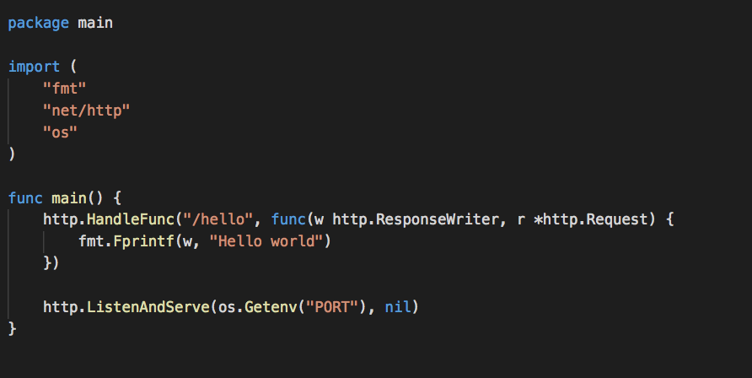
Hello world service

Slide 41
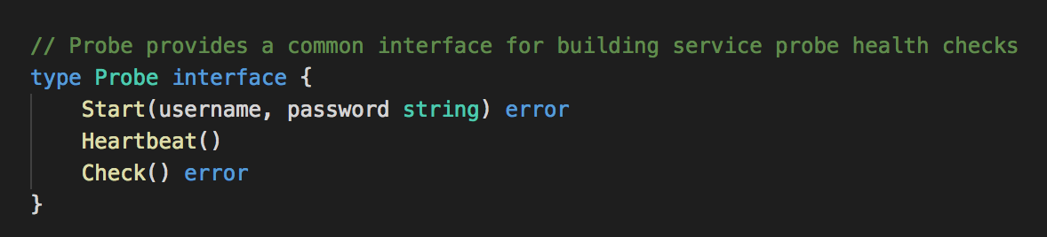
The probe interface

Slide 42
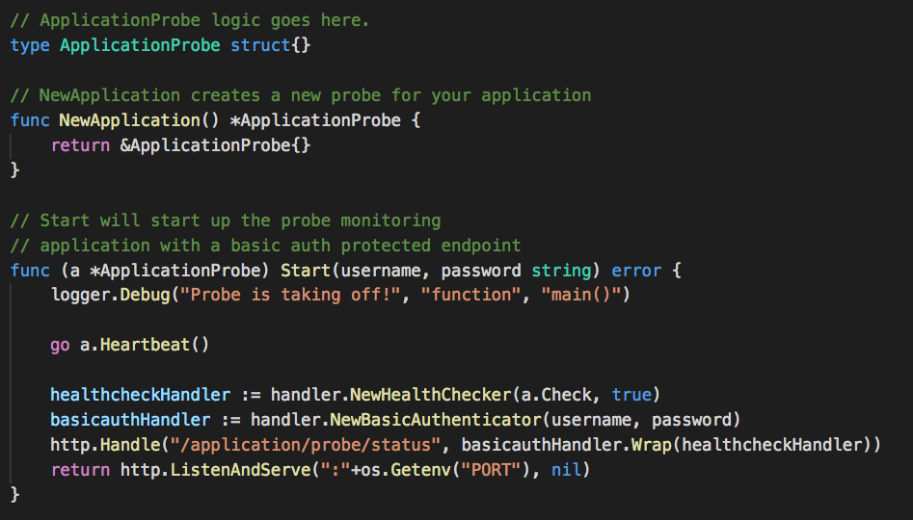
Sample probe implementation – high level flow

Slide 43
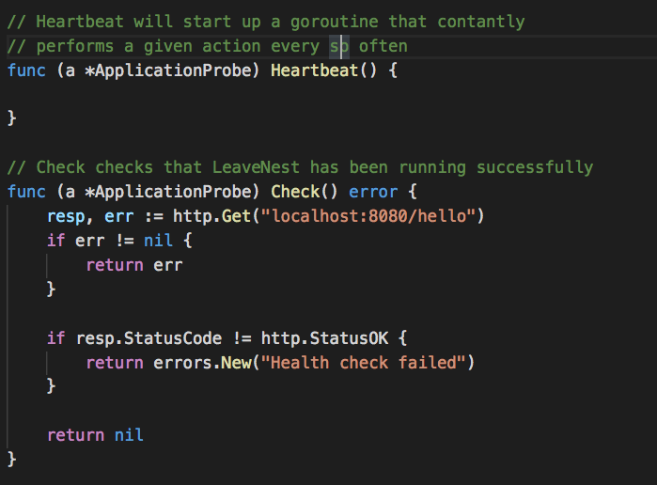
Sample probe implementation – checks

Slide 44
Engineering @ GE
Introduction to Black Box Monitoring
Black Box monitoring @ GE
Sample black box monitor
Takeaways

Slide 45
Takeaways
Node uptime != service uptime
Use Go to build black box monitors
Simulate end user traffic
GE uses this concept for many services in prod
Catches many production issues early on that white box monitoring might not

Slide 46
The “we’re hiring” slide

Slide 47
Questions?

